Slide 1
Identifying nearest neighbourhoods for Mexican Restaurant

Slide 2
Business Problem discussion
As there are many restaurants in New York City, each belonging to different categories like Chinese , Indian , French etc…So main aim of the project is to identify Mexican Restaurant in the nearest neighborhood
To identify nearest neighborhood for Mexican cuisines first we have to identify no of neighborhood for each Borough
Target audience:
1)This project will be useful to the one who is travelling to New York and wanted to taste best Mexican cuisines.
2)One who wants to open a Mexican restaurant to identify the best place for their business

Slide 3
Data Description
For this project we need the following data :
1)New York City data that contains Boroughs, Neighborhoods along with their latitude and longitude.
Data source : https://cocl.us/new_york_dataset
2) Description : This data contains the required information. And we will use this data to explore various neighborhoods of New York city. Mexican restaurants in each neighborhood of New York city
3) Data source : Foursquare API
Description : By using this API we will get the venues in each neighborhood. We can these venues to get only Mexican restaurants. For visualization Folium library is used to display of nearest neighborhoods after identifying Mexican restaurants

Slide 4
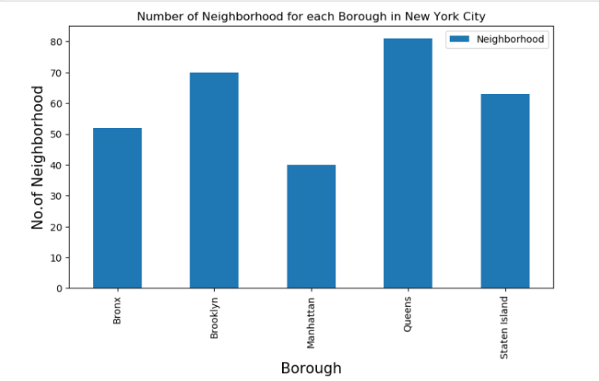
Results
Number of neighborhoods for each borough

Slide 5
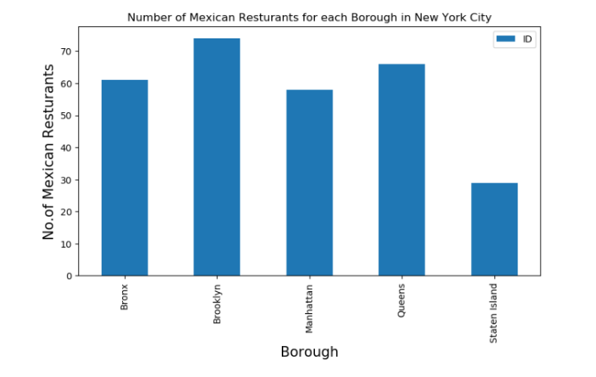
Results (Contd)
Number of Mexican Restaurants for each Borough in New York

Slide 6
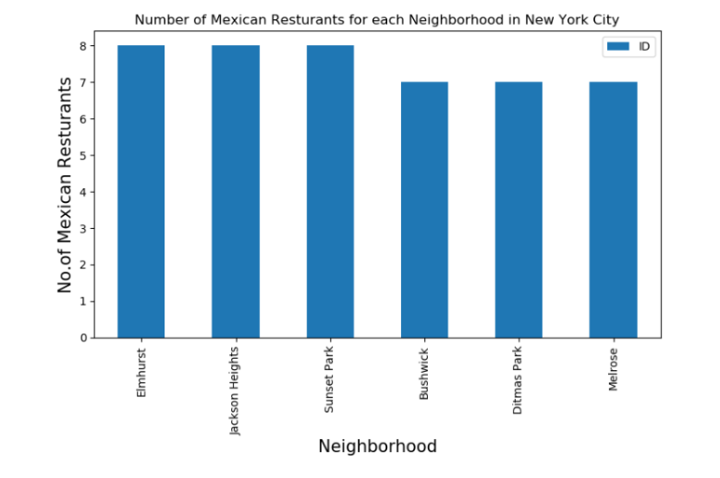
Results (Contd)
Number of Mexican Restaurants for each Neighbourhood in New York

Slide 7
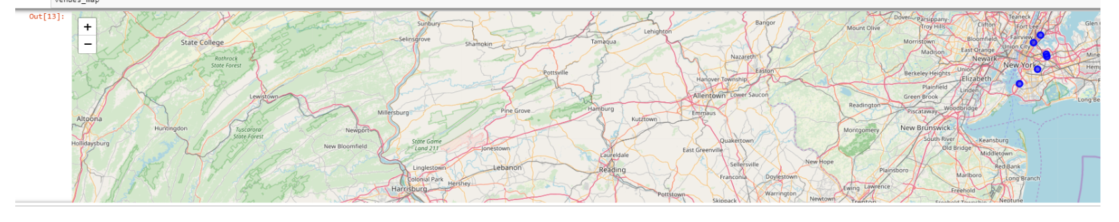
Results (Contd)
Map to show Mexican Restaurants for nearest neighbourhood

Slide 8
Conclusion
1)Elmhurst,JacksonHeights,SunsetPark are best neighborhood for Mexican restaurants
2)Queens has more no of neighborhoods

